Slide 1

Advertising Sales
Prediction
A Data Science Project by Ayesha Banu
Leveraging machine learning to optimize marketing spend and predict sales outcomes across TV, Radio, and Newspaper channels.

Slide 2
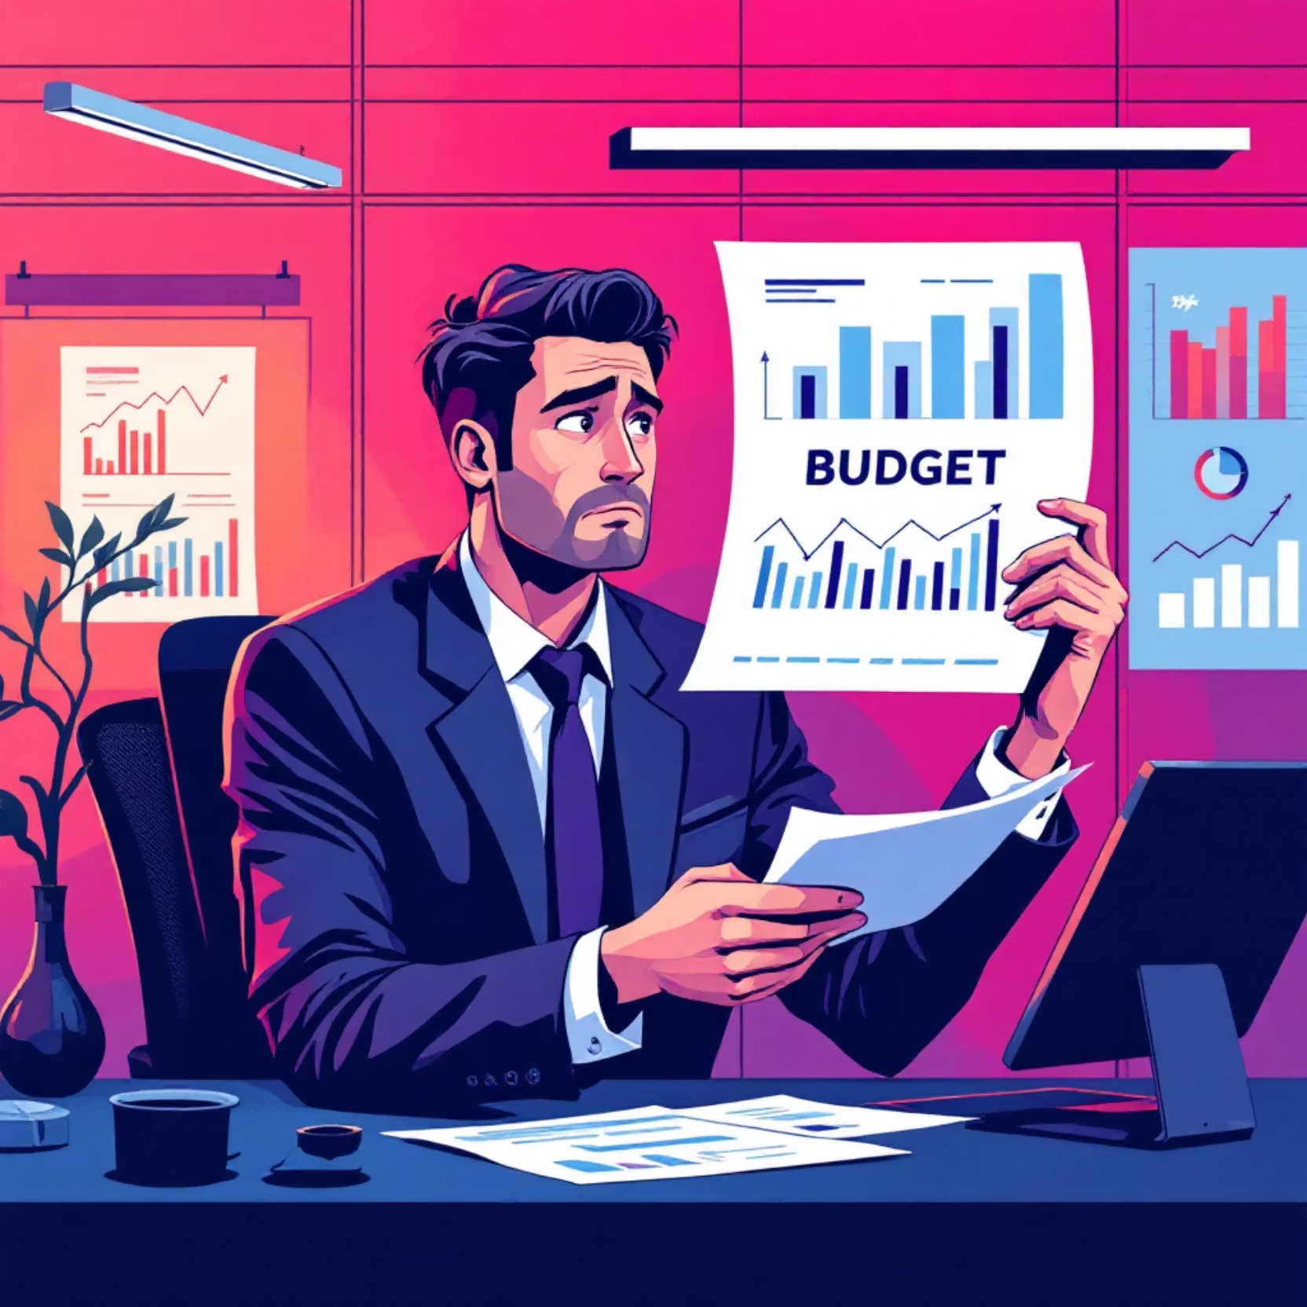
The Challenge
Marketing Investment Dilemma
Companies invest millions in advertising without understanding ROI from each channel. Traditional methods lead to inefficient budget allocation and missed opportunities.
Which channel drives the most sales?
How do channels interact together?
Can we predict future sales accurately?

Slide 3








Project Objectives
Analyze Impact
Engineer Features
Evaluate TV, Radio, and Newspaper spending effects on sales performance.
Create interaction terms like TV × Radio to capture synergistic effects.
Build Models
Deploy Solution
Compare Linear Regression, Random Forest, and Gradient Boosting algorithms.
Create Streamlit app for real-time sales predictions and business insights.

Slide 4

Dataset Overview
200 Advertising Campaigns
Each record captures marketing spend across three channels and resulting product sales.
Feature
Description
TV
Television advertising spend (thousands)
Radio
Radio advertising spend (thousands)
Newspaper
Newspaper advertising spend (thousands)
Sales
Product sales generated (target variable)
Engineered Features
Total_Ads — Combined advertising budget
TV_Radio — Interaction between TV and Radio
TV_Newspaper — TV and Newspaper synergy
Radio_Newspaper — Radio and Newspaper effect

Slide 5





End-to-End Workflow
Data Collection
Sourced Advertising.csv with 200 campaign records
Preprocessing
Removed duplicates, handled missing values, scaled features
EDA
Analyzed correlations, distributions, and outliers
Modeling
Trained and compared three regression algorithms
Deployment
Built interactive Streamlit prediction app

Slide 6
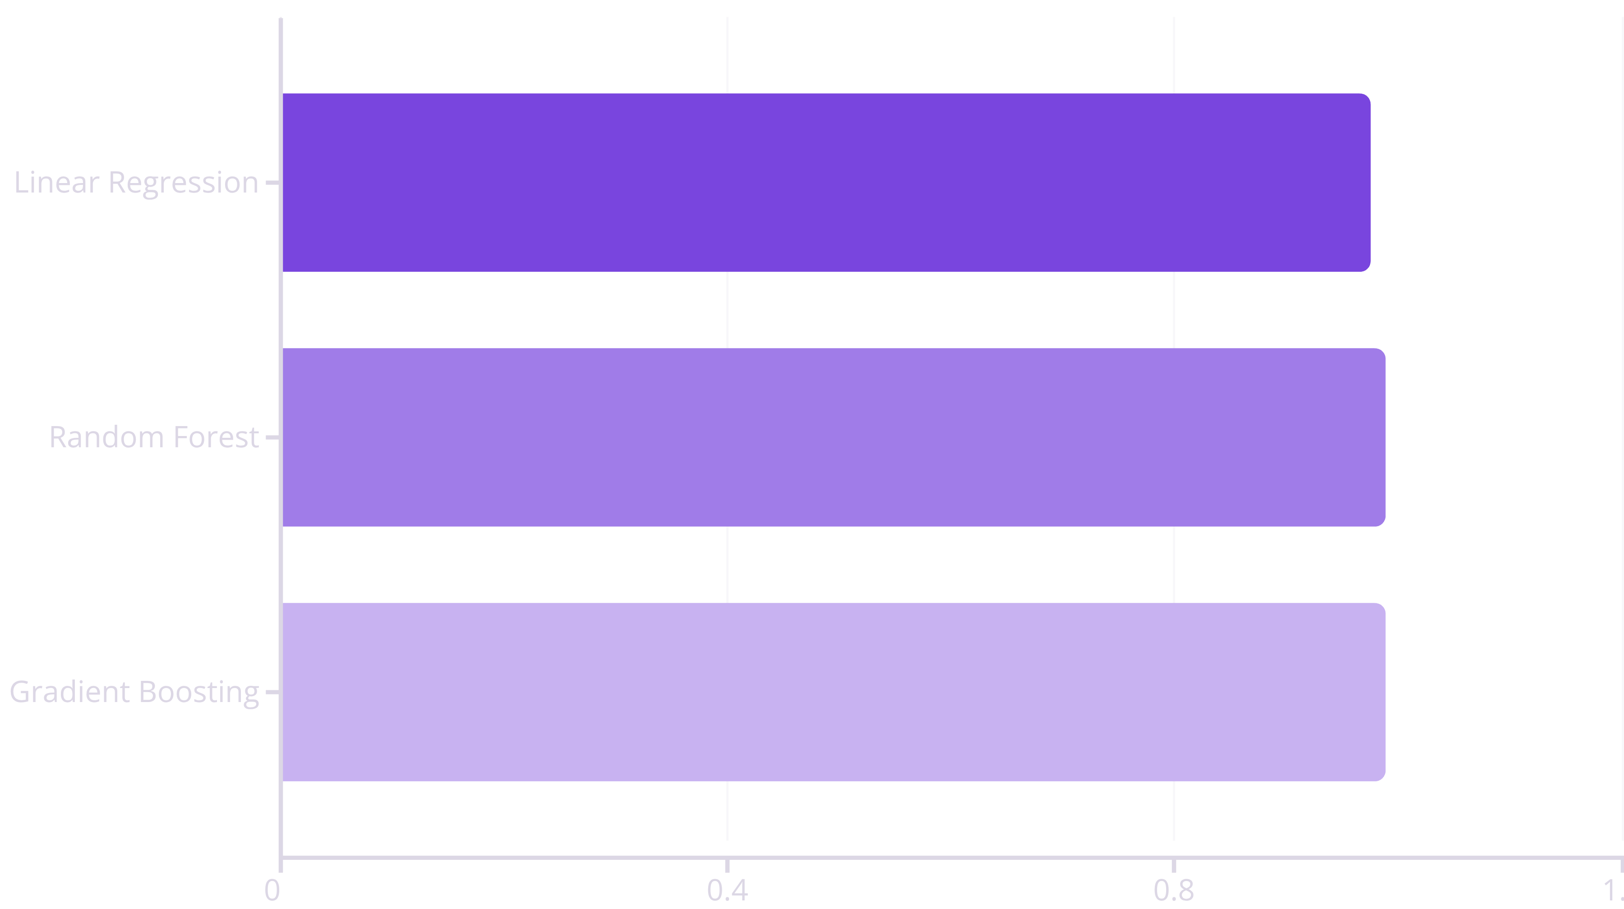
Model Performance Comparison
0.989
0.599
3
R² Score
RMSE
Models Tested
Gradient Boosting achieved highest accuracy
Lowest prediction error among all models
Comprehensive algorithm comparison

Slide 7



Key Insights Discovered
TV Dominates
Synergy Matters
Newspaper Lags
TV advertising showed the strongest correlation with sales, making it the most effective revenue driver.
Combined spending across channels (TV × Radio) boosted sales more than isolated investments.
Newspaper advertising contributed least to sales but added value through channel interactions.
"Multi-channel advertising strategies outperform single-channel approaches by capturing synergistic effects between platforms."

Slide 8
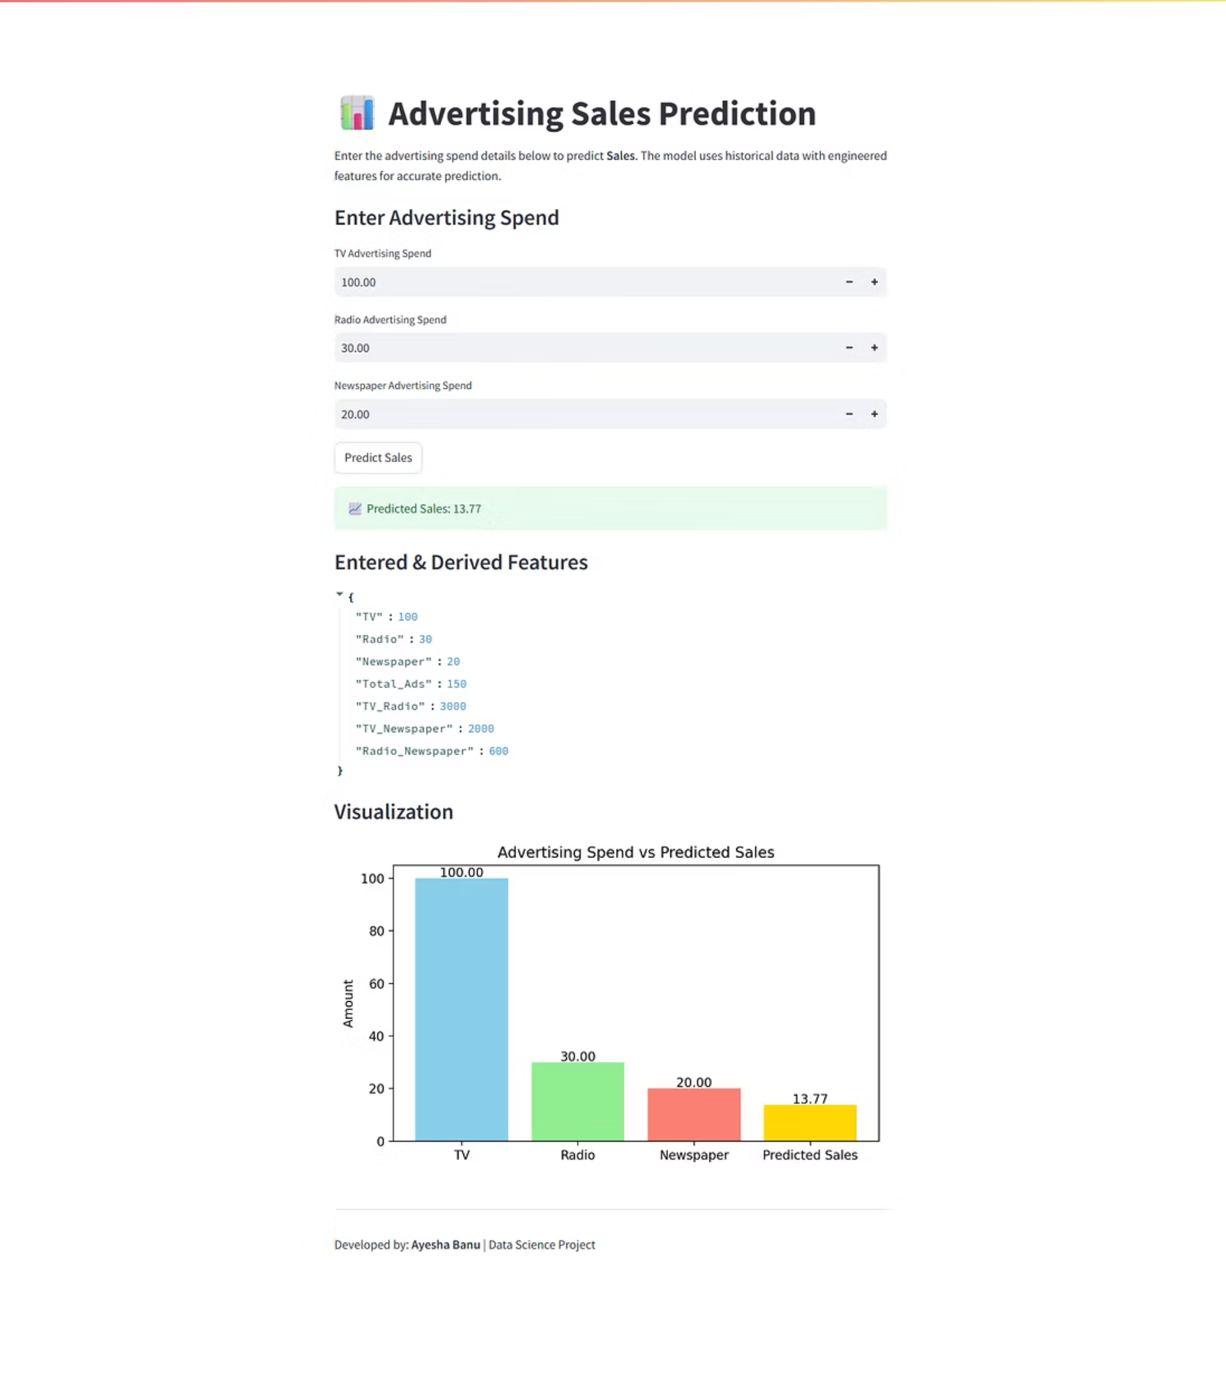
Streamlit Deployment
01
User Input
Enter advertising spend for TV, Radio, and Newspaper channels
02
Feature Engineering
App automatically calculates interaction terms and total spend
03
Prediction
Gradient Boosting model generates real-time sales forecast
04
Results Display
Shows predicted sales value and entered data for transparency

Slide 9



Business Impact & Future Vision
Marketing Optimization
Cost Reduction
Revenue Growth
Identify most effective channels and allocate resources strategically for maximum ROI.
Eliminate wasteful spending on low-impact channels, saving thousands in marketing budgets.
Predict and maximize future sales outcomes through data-driven campaign planning.
Future Enhancements
Integrate digital channels: Social Media, Search Engine Marketing, Email Campaigns
Deploy cloud-based REST API for enterprise system integration
Add ROI analysis module and budget optimization algorithms
Implement time-series forecasting for long-term sales trends

Slide 10




Project Success
Transforming Marketing Strategy
This project demonstrates how machine learning transforms advertising from intuition-based decisions to scientifically optimized processes.
The deployed solution provides business teams with a reliable decision support system for budget optimization and revenue maximization.
Completed: October 2025Organization: Oasis Infobyte Data Science InternshipDeveloper: Ayesha Banu

